Slide 1

Blockchain for Supply Chains to counter Counterfeit Products Cryptography (BITS F463)
Naren Surampudi (2016AAPS0206H)

Slide 2
What is Blockchain?
A time-stamped series of immutable records of data
Each “block” of data is bound to the others using cryptographic principles or “chain”
Carries no transaction cost
Each transaction needs to be verified using a consensus mechanism for adding the transaction “block” permanently into the “chain”
No central authority to approve transactions- Peer-to-peer trustless mechanism

Slide 3
What is Supply Chain?
System of organizations, people, activities, resources etc. involved in moving a product/service from the supplier to the customer
Varies according to the needs of the company as well as the industry in which the respective company is operating in

Slide 4
Why Blockchain for Supply Chain?
One of the most common problem plaguing many industries is the presence of fake products
When fake products make their way into the market, they not only reduce the revenue of the organizations, but also potentially erode customer relations and in worse cases, also present a risk to the lives of customers
One solution for combating this is to combine the traditional supply chain on ground with blockchain technology
This aims to keep track of the flow of a product starting from the place of it’s manufacture all the way to the outlets from where the customers can pick the product
By using blockchain, we can trace the path of the product from some point, to all the previous points in it’s supply chain

Slide 5
How does this work?
At every stage in the supply chain of a product, blocks of information are pushed into the blockchain of the respective product
This means that a single product will have a blockchain of it’s own, with the blockchain representing it’s entire journey, from the manufacturing plant to the outlets
At every stage in the journey, the product will be “scanned” and the relevant data uploaded onto the blockchain before proceeding onto the next destination
The main role of the blockchain comes into play either when a customer purchases the product or takes it to a service centre in some cases.
By making use of this blockchain, the product can be verified if it is an original or counterfeit by simply checking if the product fits into the supply chain or not. If it does not, it means that the product is a counterfeit

Slide 6
How does this work?
Throughout the traversal of a product through the supply chain, a “block” is added onto the blockchain for every stop of the product
For example, a block maybe added at some manufacturing plant, another block maybe added at the shipment location etc
This will not only add more security to the entire supply chain, but also add a sense of transparency as now anyone can now simply look at the traversal of the product by scanning a barcode, QR code or anything similar

Slide 7
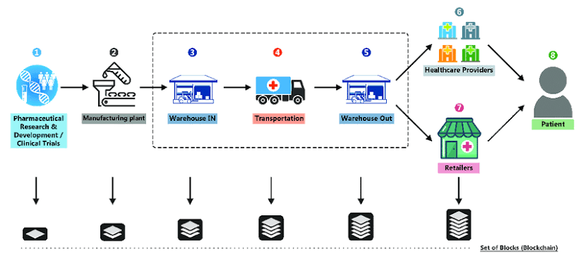
Traditional Supply Chain (Pharmaceuticals)

Slide 8
Supply Chain (Pharmaceuticals) with Blockchain

Slide 9
Major Benefits
Increased effectiveness when dealing with counterfeit products as any fake “block” will not fit into the “chain” of an original product’s supply chain
This method can also be used by customers to track the product they wish to buy, with information of it’s origins and path possibly being made available by the organizations- potentially increases transparency

Slide 10
Thank You

